Slide 1
Image Processing / Computer Vison Applications
Dr. Partha Pratim Das
Department of Computer Science and Engineering of
Indian Institute of Technology, Kharagpur

Slide 2
Sample Applications
Edge Detection
Pedestrian Detection
Handwritten Digit Recognition

Slide 3
Edge Detection
Dataset
The Berkeley Segmentation Dataset and Benchmark: https://www2.eecs.berkeley.edu/Research/Projects/CS/vision/bsds/
Reference:
Edge Detection – State of the Art, P. Dollar and C. Zitnick, 2014: http://www.cs.utoronto.ca/~fidler/slides/CSC420/lecture5.pdf

Slide 4
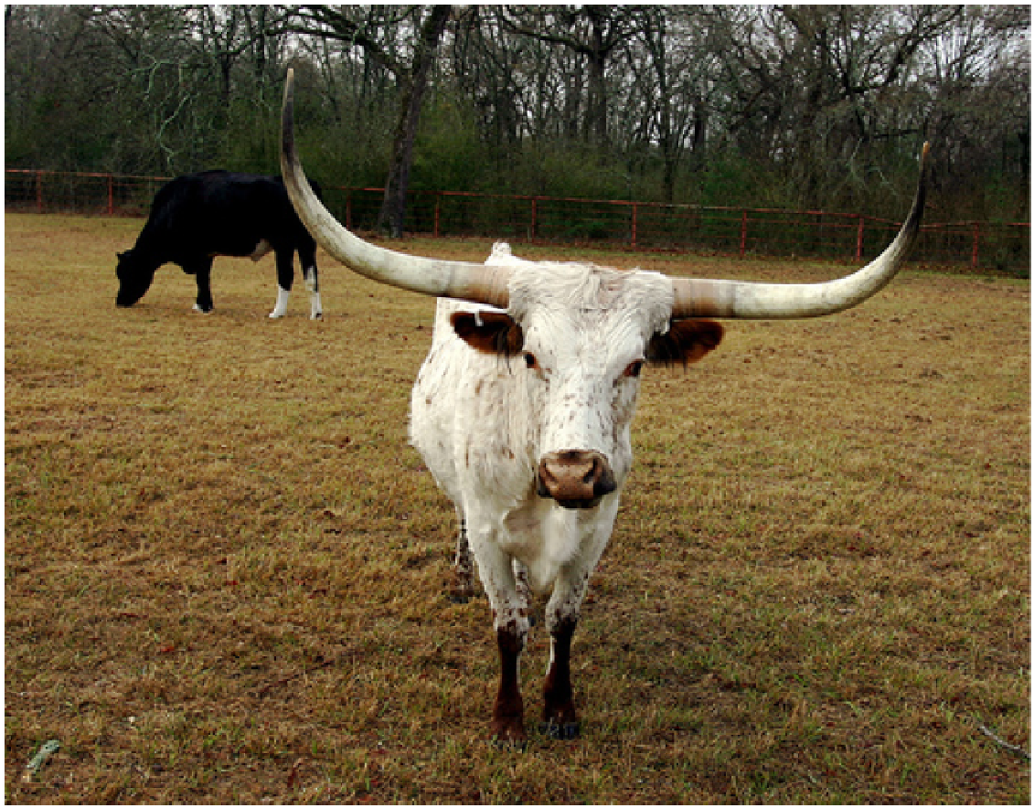
Test Canny Edge Detector
Source: http://www.cs.utoronto.ca/~fidler/slides/CSC420/lecture5.pdf

Slide 5
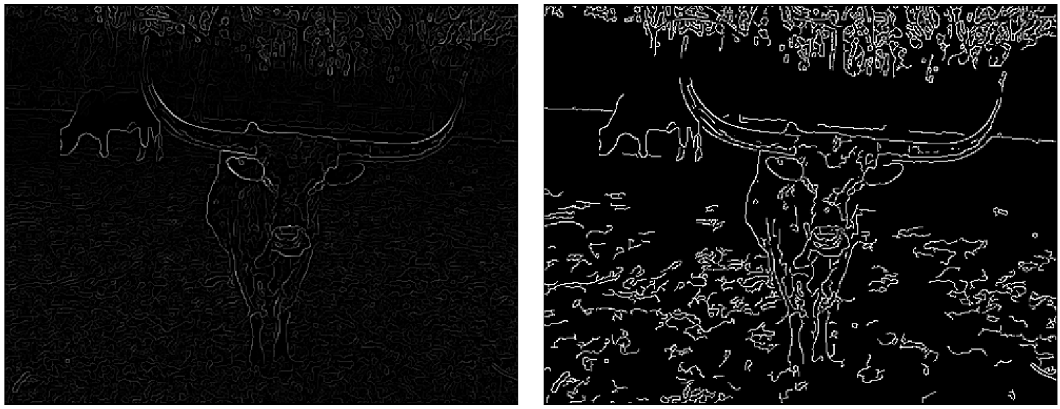
Test Canny Edge Detector
_{Gradients + NMS}
_{Canny’s Edges}
Source: http://www.cs.utoronto.ca/~fidler/slides/CSC420/lecture5.pdf

Slide 6
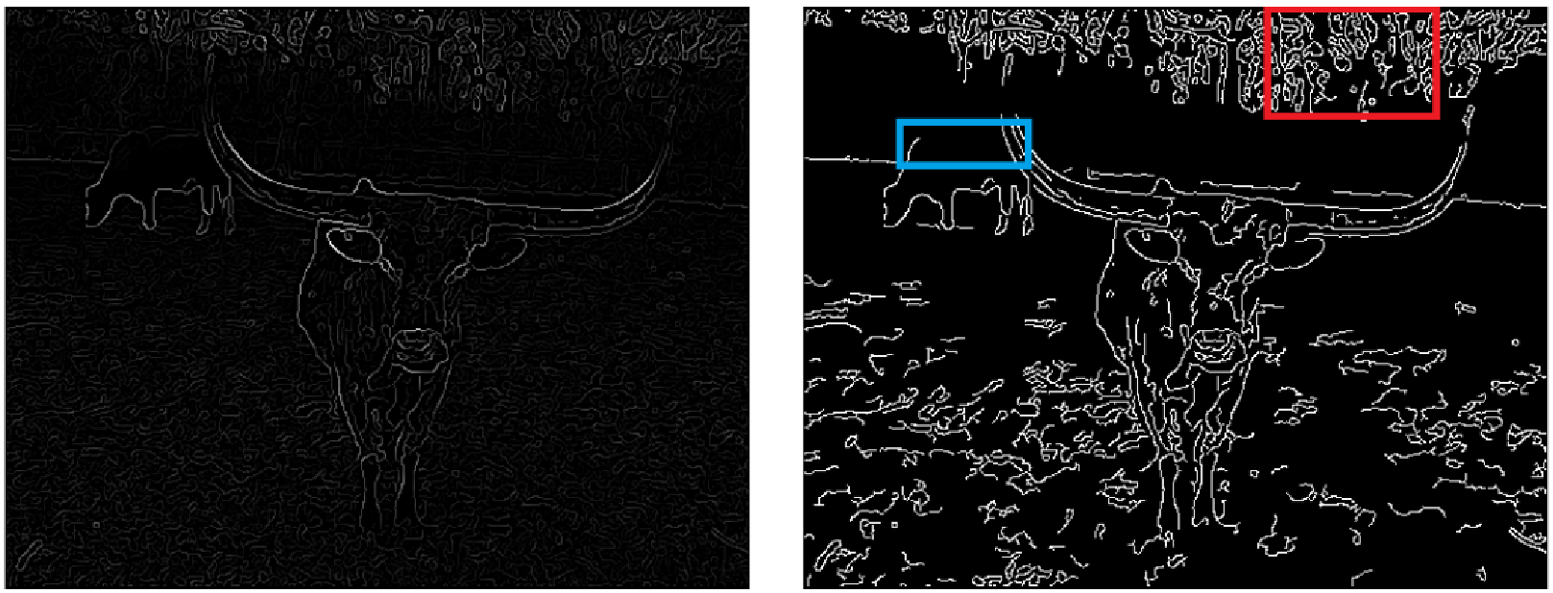
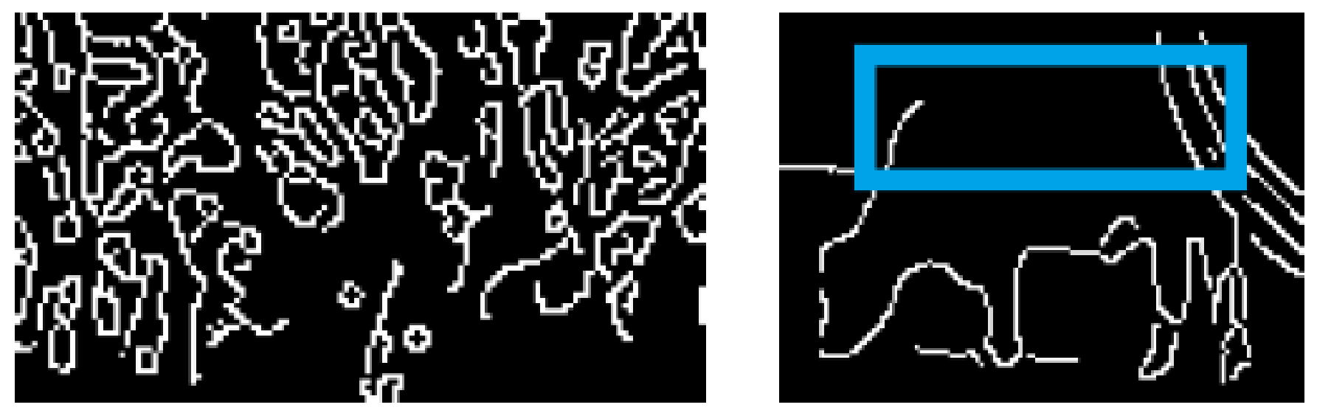
Test Canny Edge Detector
_{Gradients + NMS}
_{Canny’s Edges}
Lots of “distractor” and missing edges
_{Can we do better?}
Source: http://www.cs.utoronto.ca/~fidler/slides/CSC420/lecture5.pdf

Slide 7
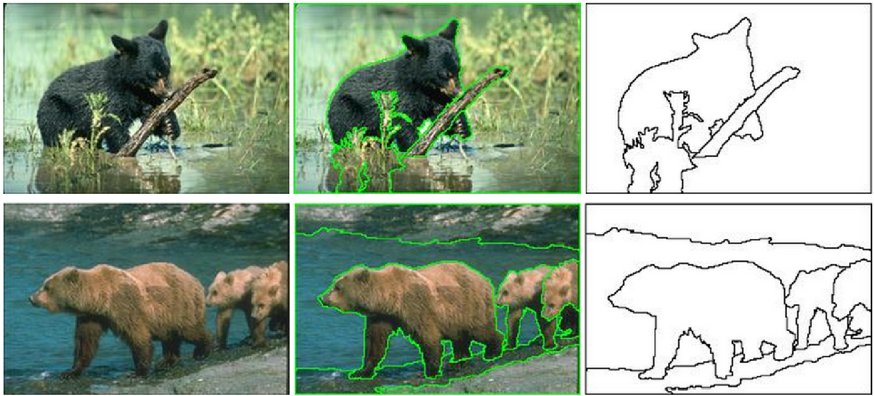
Edge Annotation
The Berkeley Segmentation Dataset and Benchmark by D. Martin and C. Fowlkes and D. Tal and J. Malik
Source: http://www.cs.utoronto.ca/~fidler/slides/CSC420/lecture5.pdf

Slide 8
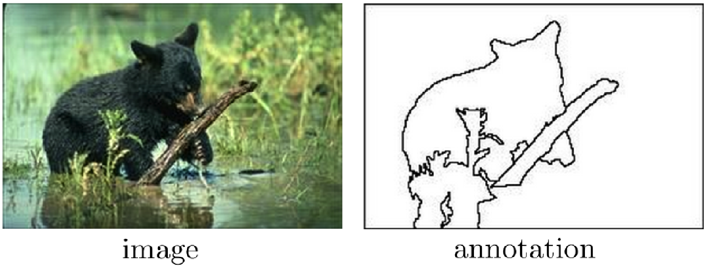
Train an Edge Detector
Separate edge annotations
Source: http://www.cs.utoronto.ca/~fidler/slides/CSC420/lecture5.pdf

Slide 9
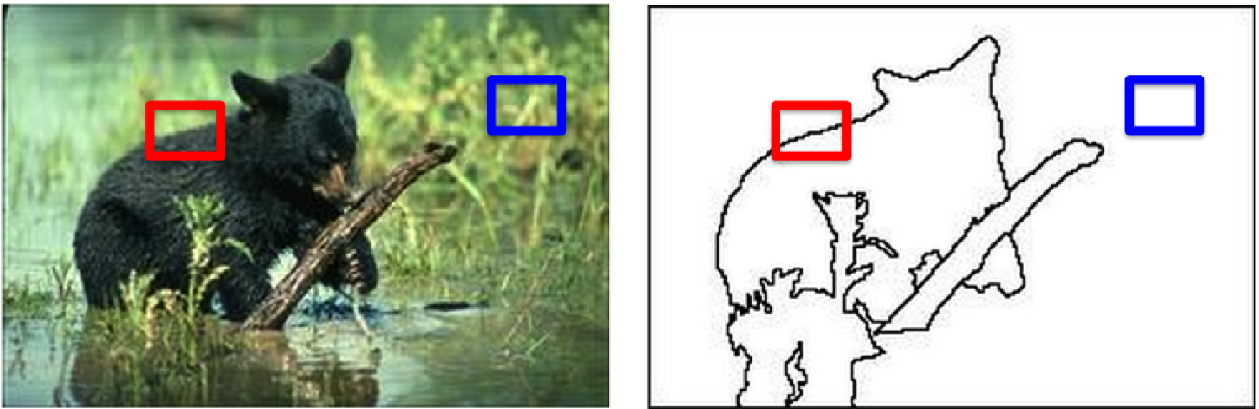
Train an Edge Detector
Extract a lot of image patched
Source: http://www.cs.utoronto.ca/~fidler/slides/CSC420/lecture5.pdf

Slide 10
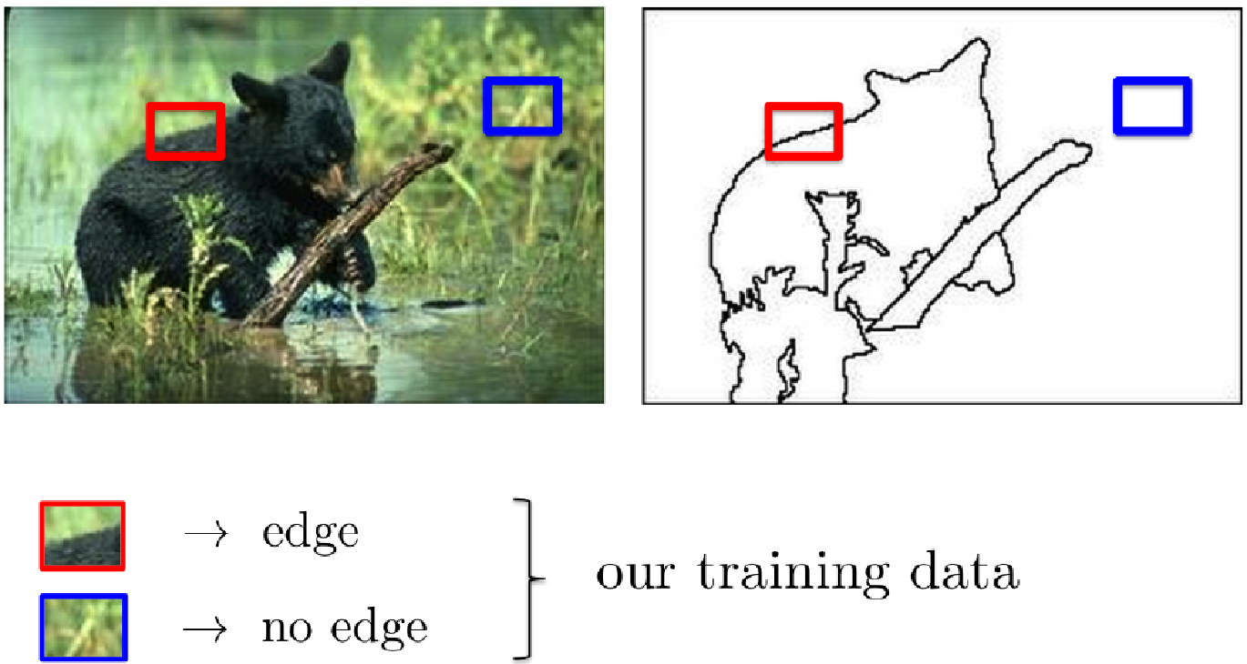
Train an Edge Detector
Mark edge / no edge for training
Source: http://www.cs.utoronto.ca/~fidler/slides/CSC420/lecture5.pdf

Slide 11
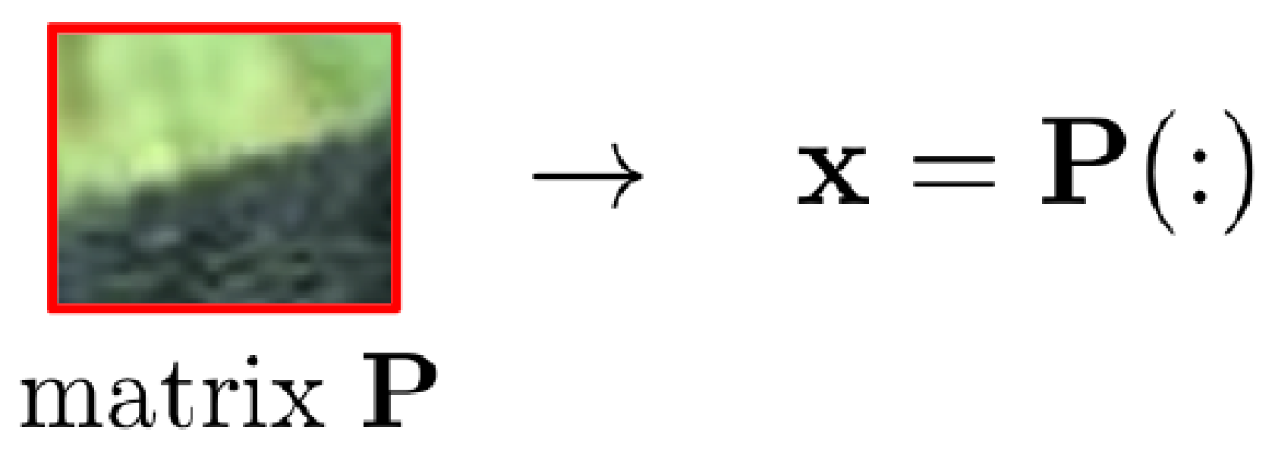
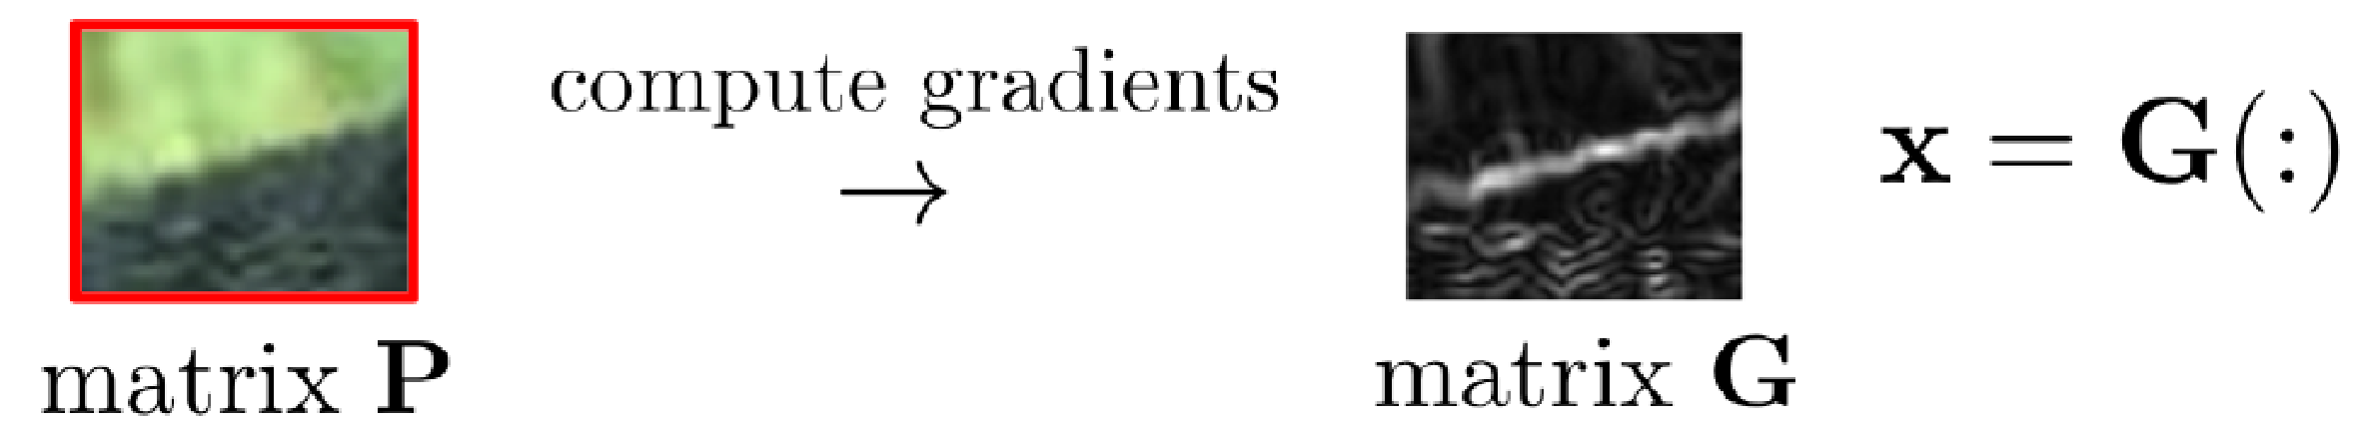
Train an Edge Detector
We convert each image patch P (a matrix) into a vector x
Extract image features for each patch
Train SVM
Source: http://www.cs.utoronto.ca/~fidler/slides/CSC420/lecture5.pdf

Slide 12
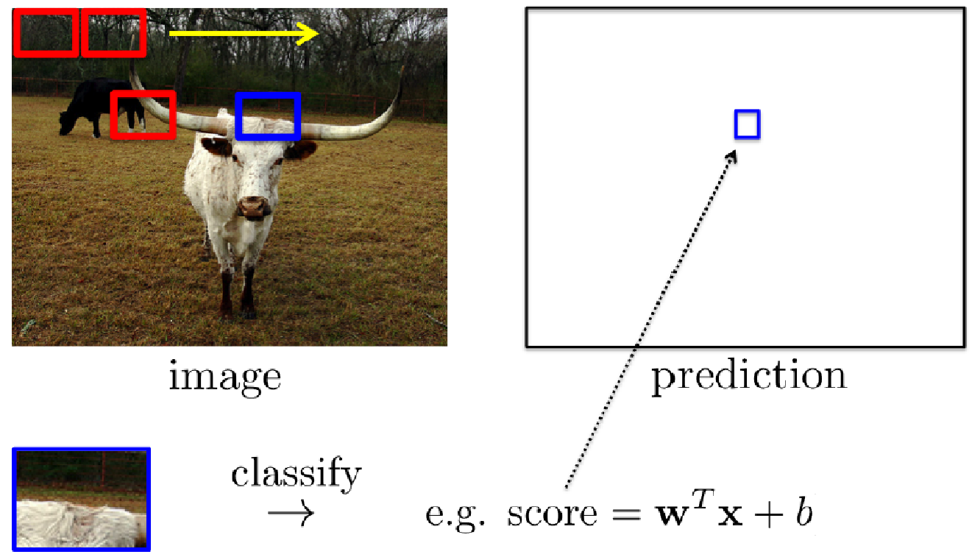
Using an Edge Detector
Extract all image patches
Extract features and use the trained classiﬁer
Place the predicted value (score) in the output matrix
Source: http://www.cs.utoronto.ca/~fidler/slides/CSC420/lecture5.pdf

Slide 13
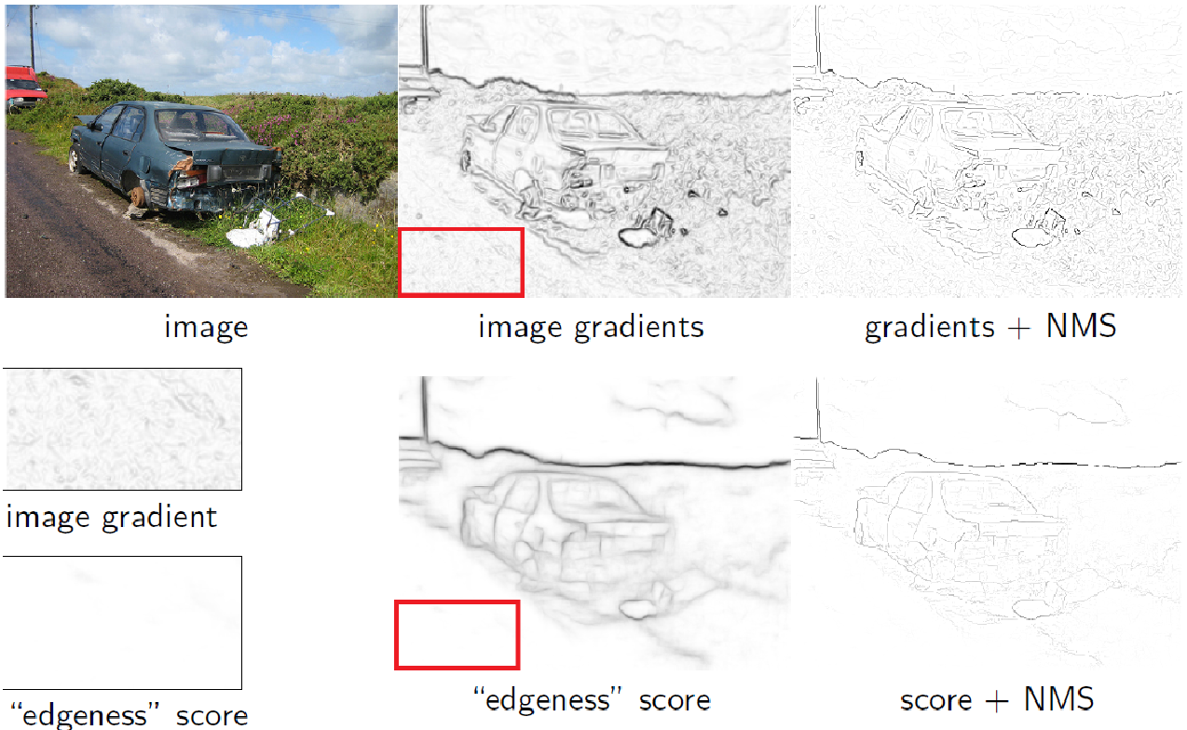
Comparison: Canny vs Structured Edge Detector
Source: http://www.cs.utoronto.ca/~fidler/slides/CSC420/lecture5.pdf

Slide 14
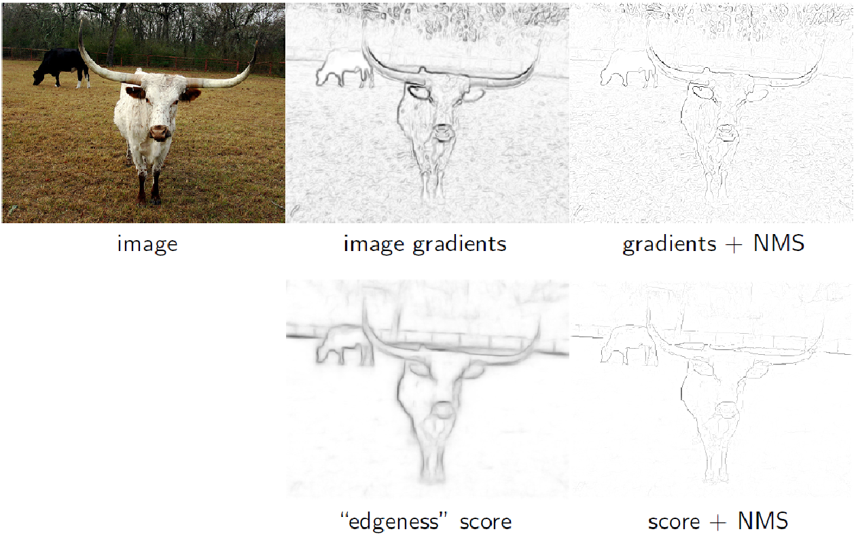
Comparison: Canny vs Structured Edge Detector
Source: http://www.cs.utoronto.ca/~fidler/slides/CSC420/lecture5.pdf

Slide 15
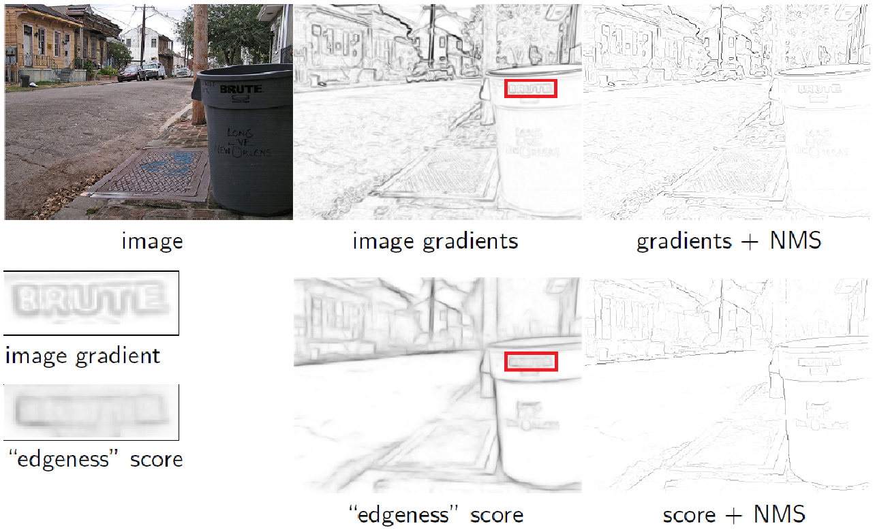
Comparison: Canny vs Structured Edge Detector
Source: http://www.cs.utoronto.ca/~fidler/slides/CSC420/lecture5.pdf

Slide 16
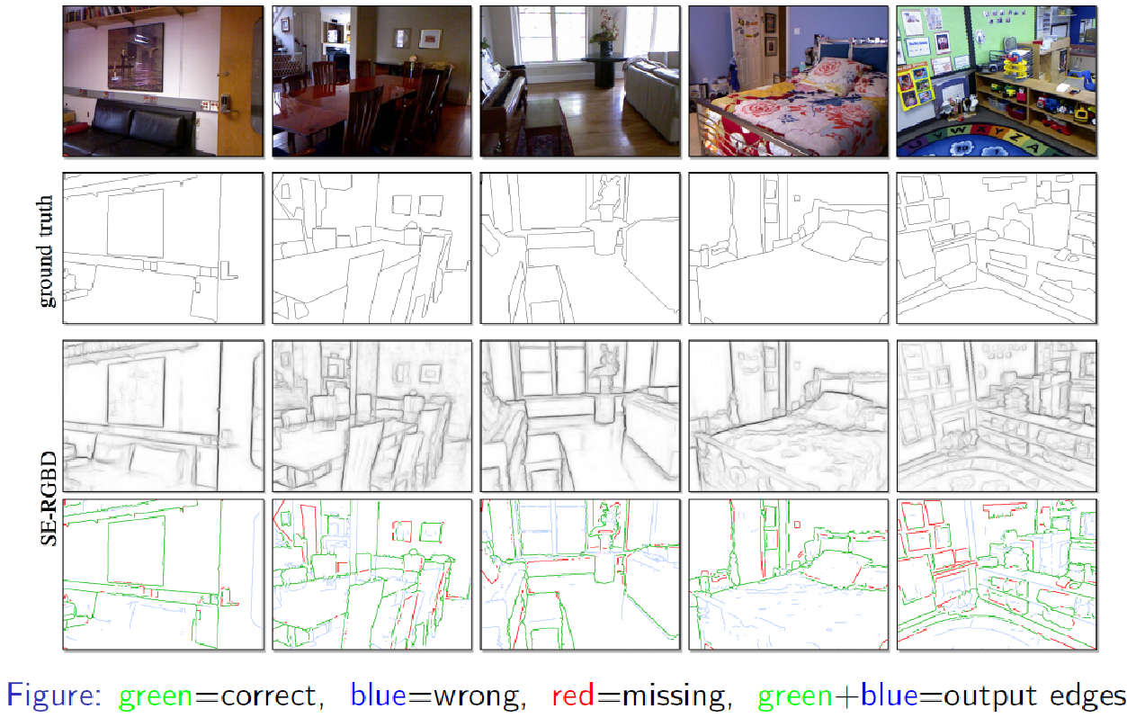
Evaluation
Source: http://www.cs.utoronto.ca/~fidler/slides/CSC420/lecture5.pdf

Slide 17
Evaluation
Source: http://www.cs.utoronto.ca/~fidler/slides/CSC420/lecture5.pdf

Slide 18
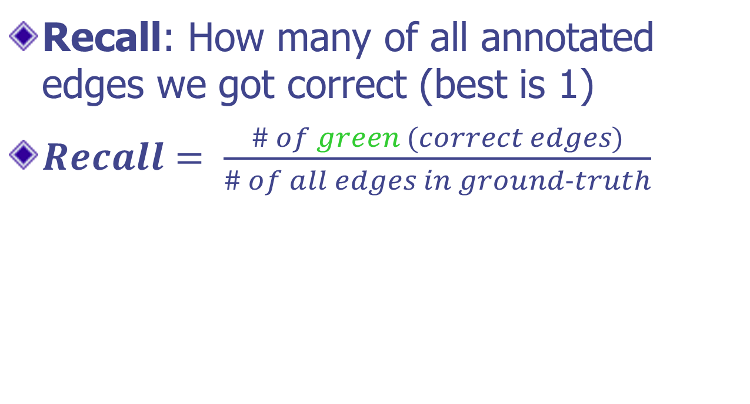
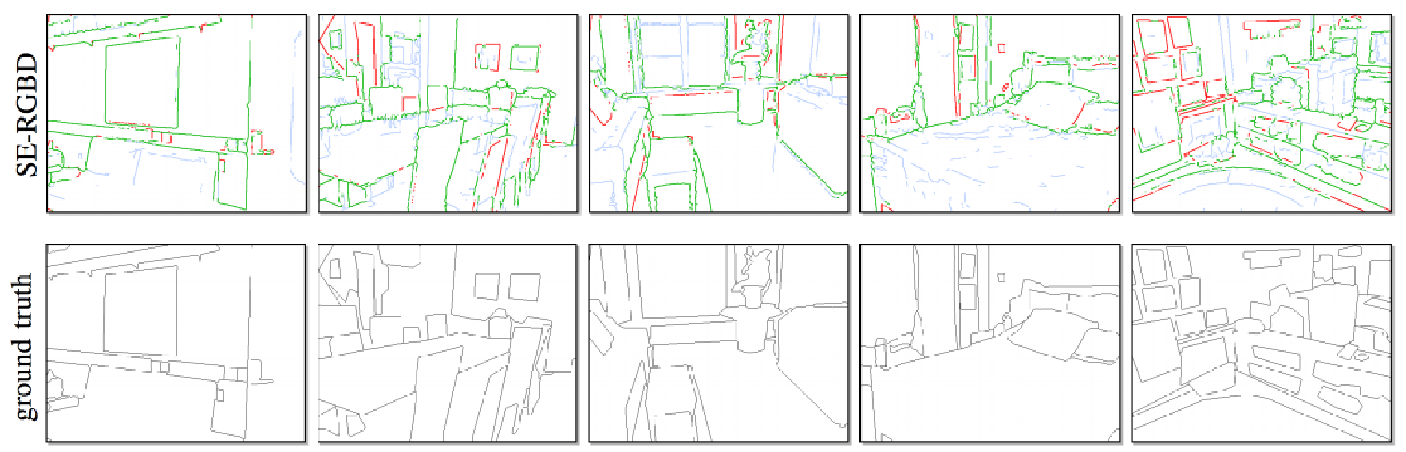
Evaluation
Source: http://www.cs.utoronto.ca/~fidler/slides/CSC420/lecture5.pdf

Slide 19
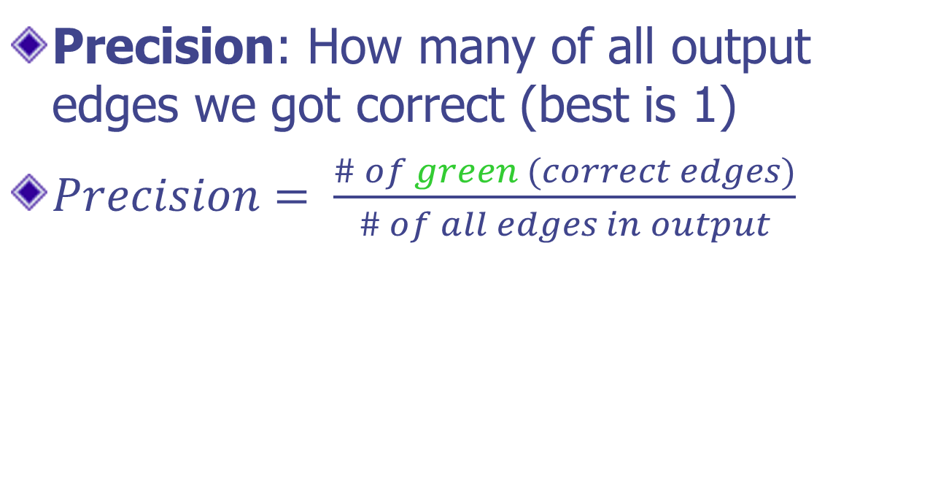
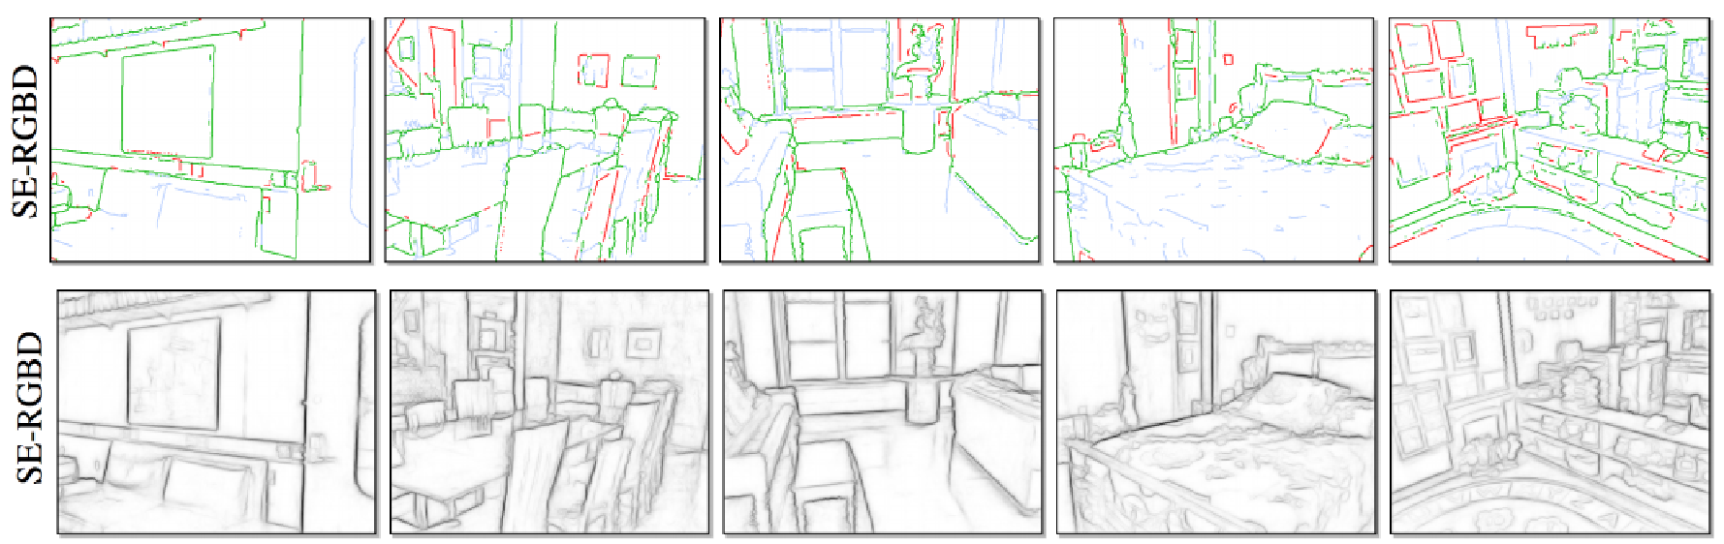
Evaluation
Source: http://www.cs.utoronto.ca/~fidler/slides/CSC420/lecture5.pdf

Slide 20
Pedestrian Detection
Dataset
INRIA: http://pascal.inrialpes.fr/data/human
Reference:
CS231A Project report, Cecile Foret, March 19, 2014: http://cvgl.stanford.edu/teaching/cs231a_winter1415/prev/projects/pedestrian.pdf

Slide 21
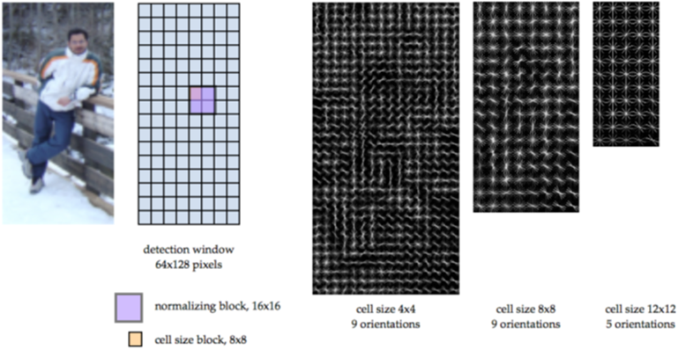
Pedestrian Detection
HOG descriptor representation, for different cell sizes, and number of orientation bins
Source: http://cvgl.stanford.edu/teaching/cs231a_winter1415/prev/projects/pedestrian.pdf

Slide 22
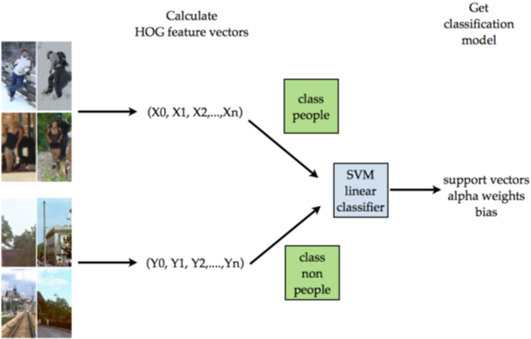
Pedestrian Detection
Training the detection model using HOG descriptor, using two classes: people vs non-people
Source: http://cvgl.stanford.edu/teaching/cs231a_winter1415/prev/projects/pedestrian.pdf

Slide 23
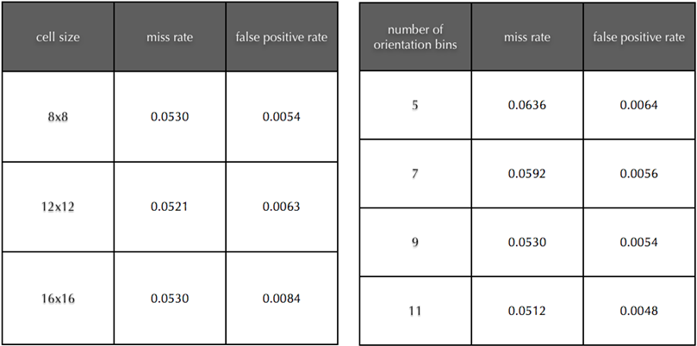
Pedestrian Detection
Number of orientation bins for the HOG descriptor is set to 9
Cell size for the HOG descriptor is set to 8x8
Source: http://cvgl.stanford.edu/teaching/cs231a_winter1415/prev/projects/pedestrian.pdf

Slide 24
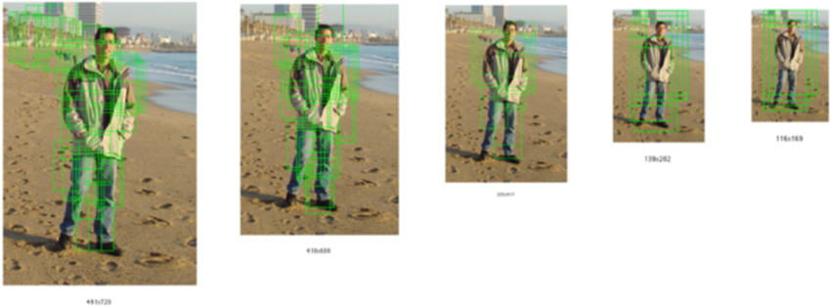
Pedestrian Detection
Exhaustive search using sliding window over a pyramid scaled images, using SVM classifier
Source: http://cvgl.stanford.edu/teaching/cs231a_winter1415/prev/projects/pedestrian.pdf

Slide 25
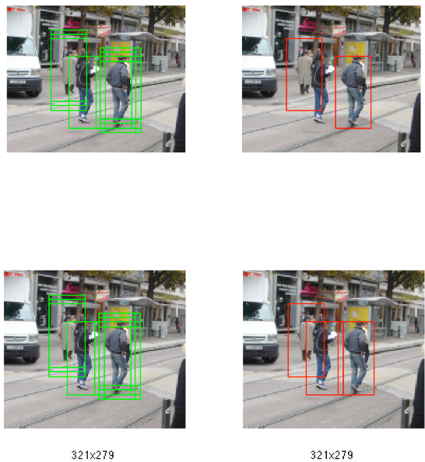
Pedestrian Detection
Non-Maxima suppression with different window sizes, when looking for local maximum of weight cost
Source: http://cvgl.stanford.edu/teaching/cs231a_winter1415/prev/projects/pedestrian.pdf

Slide 26
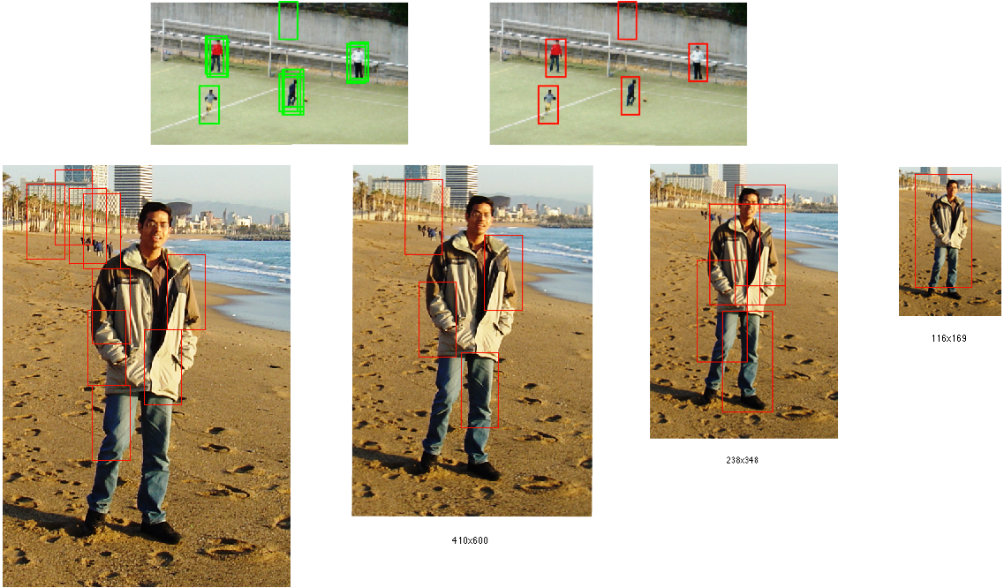
Pedestrian Detection
Non-Maxima suppression with single or multiple distinct matches. Primary detection is done using a model retrained with hard negative cases
Source: http://cvgl.stanford.edu/teaching/cs231a_winter1415/prev/projects/pedestrian.pdf

Slide 27
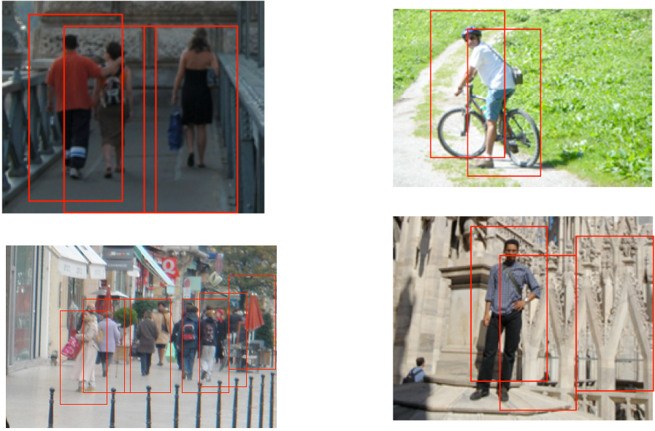
Pedestrian Detection
Detection with different illumination, pose, scale, occlusions scenarios
Source: http://cvgl.stanford.edu/teaching/cs231a_winter1415/prev/projects/pedestrian.pdf

Slide 28
Handwritten Digit Recognition
Dataset
MNIST: Yann LeCun, Courant Institute, Corinna Cortes, and Christopher J.C. Burges
http://yann.lecun.com/exdb/mnist/
Reference:
Fast and Accurate Digit Classification, Subhransu Maji & Jitendra Malik, Technical Report No. UCB/EECS-2009-159, 2009
http://www.eecs.berkeley.edu/Pubs/TechRpts/2009/EECS-2009-159.html

Slide 29
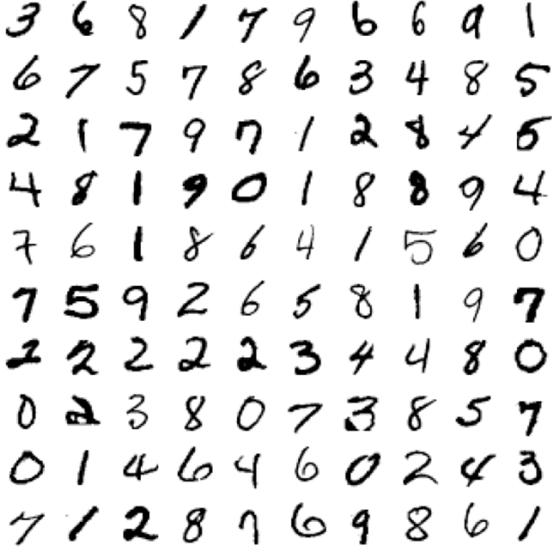
Size-normalized examples from MNIST Dataset

Slide 30
MNIST Dataset
Has a training set of 60 K examples (6K examples for each digit), and a test set of 10K examples.
Each digit is a 28 x 28 pixel grey level image. The digit itself occupies the central 20 x 20 pixels, and the center of mass lies at the center of the box.
“It is a good database for people who want to try learning techniques and pattern recognition methods on real-world data while spending minimal efforts on preprocessing and formatting.”

Slide 31
The ML Approach
Training time
Compute feature vectors for positive and negative examples of image patches
Train a classifier
Test Time
Compute feature vector on image patch
Evaluate classifier

Slide 32
Feature Design
Pixel brightness values
Flat: 28x28 into a feature vector
Pyramid: Hierarchical with a grid of cell size c × c
Downsize with c =1 (original), 2, 3, 4, 5, 6, 7 and 14 (2x2 only) with overlapping grids offset by half the cell size
Orientation histograms
Each pixel in the image is assigned an orientation and magnitude based on the local gradient
Histograms are constructed by aggregating the pixel responses within cells of various sizes – 14×14, 7×7 and 4×4 with overlap of half the cell size.
The histograms at each level are multiplied by weights 1, 2 and 4 and concatenated together to form a single histogram which are then used to train kernel SVMs.

Slide 33
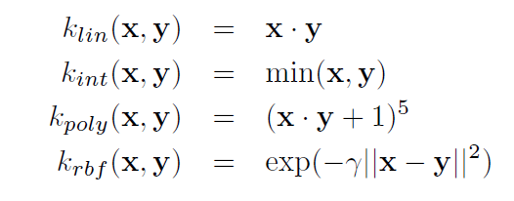
SVM Kernels
Linear
Intersection kernel
Polynomial
Gaussian Radial Basis Function

Slide 34
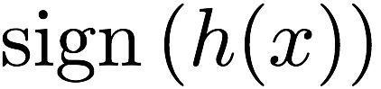
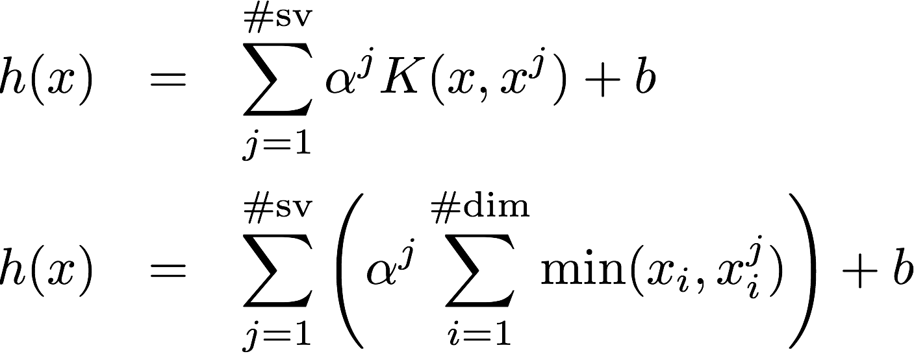
Kernelized SVMs slow to evaluate
Decision function is where:
_{Feature vector}
_{to evaluate}
_{Sum over all}
_{support vectors}
_{Kernel Evaluation}
_{Feature corresponding}
_{to a support vector l}
_{Arbitrary}
_{Kernel}
_{Histogram}
_{Intersection}
_{Kernel}
Cost: # Support Vectors x Cost of kernel computation

Slide 35
Kernelized SVMs slow to evaluate
Decision function is where:
_{Feature vector}
_{to evaluate}
_{Sum over all}
_{support vectors}
_{Kernel Evaluation}
_{Feature corresponding}
_{to a support vector l}
_{Arbitrary}
_{Kernel}
_{Histogram}
_{Intersection}
_{Kernel}
_{SVM with Kernel Cost:}
# Support Vectors x Cost of kernel comp.
_{IKSVM Cost:}
# Support Vectors x # feature dimensions

Slide 36
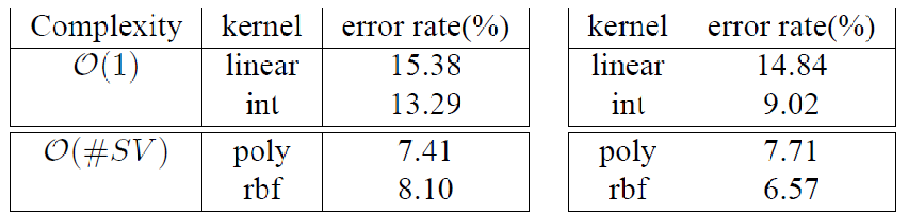
Results 1
Error rates on the MNIST dataset using raw pixels (left) and pyramid of raw pixels (right)
Only the first 1000 examples used for training, all 10,000 used for test

Slide 37
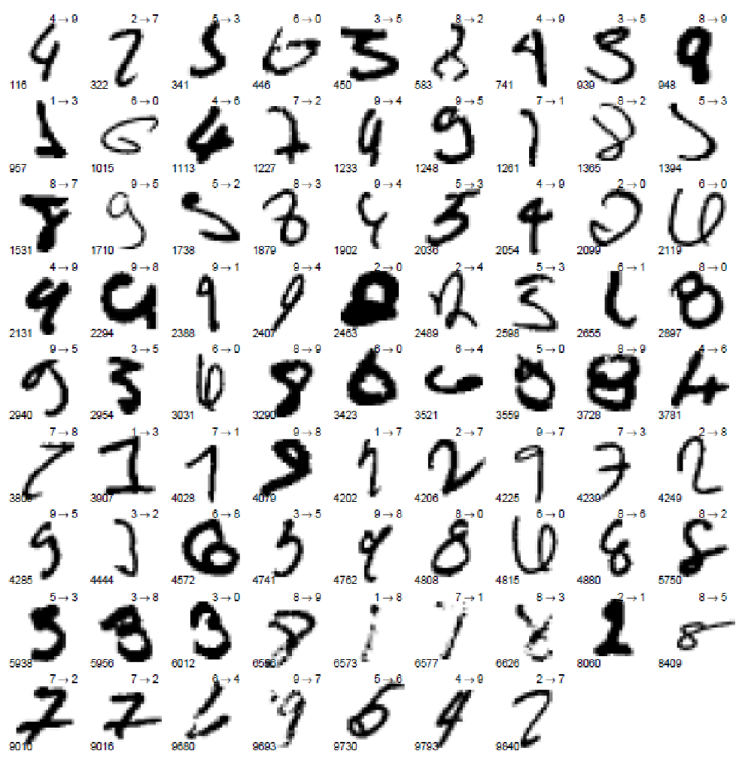
All the 79 misclassifications using pyramid HOG features with the intersection kernel SVM, on the MNIST dataset. X → Y on the top right corner of each example denotes that X is misclassified as Y. The number in the bottom left corner is the index of the example in the test set.

Slide 38
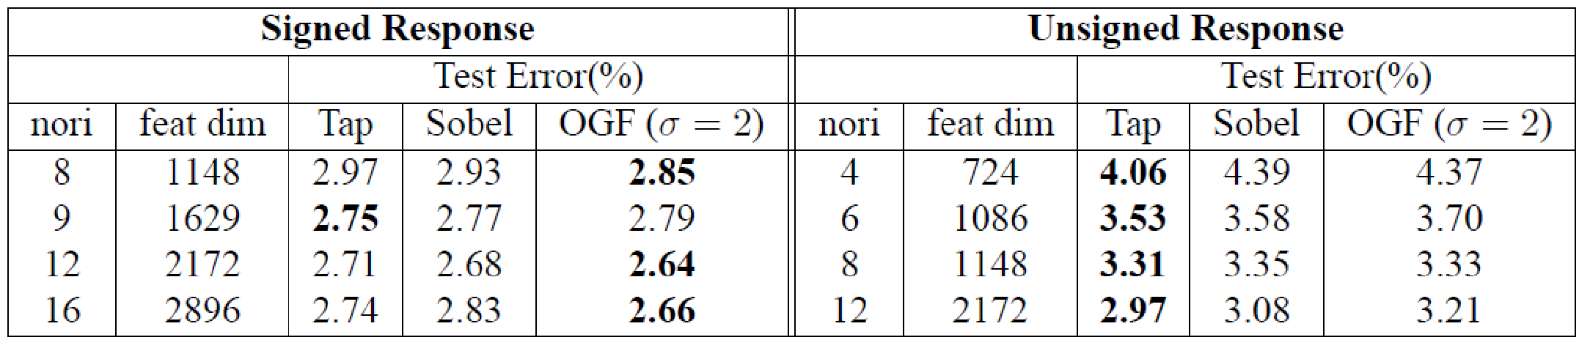
Results 2
Error rates on the MNIST dataset using pyramid of histograms of oriented gradients
Only the first 1000 examples used for training, all 10,000 used for test
The orientation could be signed (0º – 360º) or unsigned (0º – 180º). The signed gradient distinguishes between black to white and white to black transitions which might be useful for digits.
_{Tap → Tap Filter}
_{OGF → Oriented Gradient Filter}

Slide 39
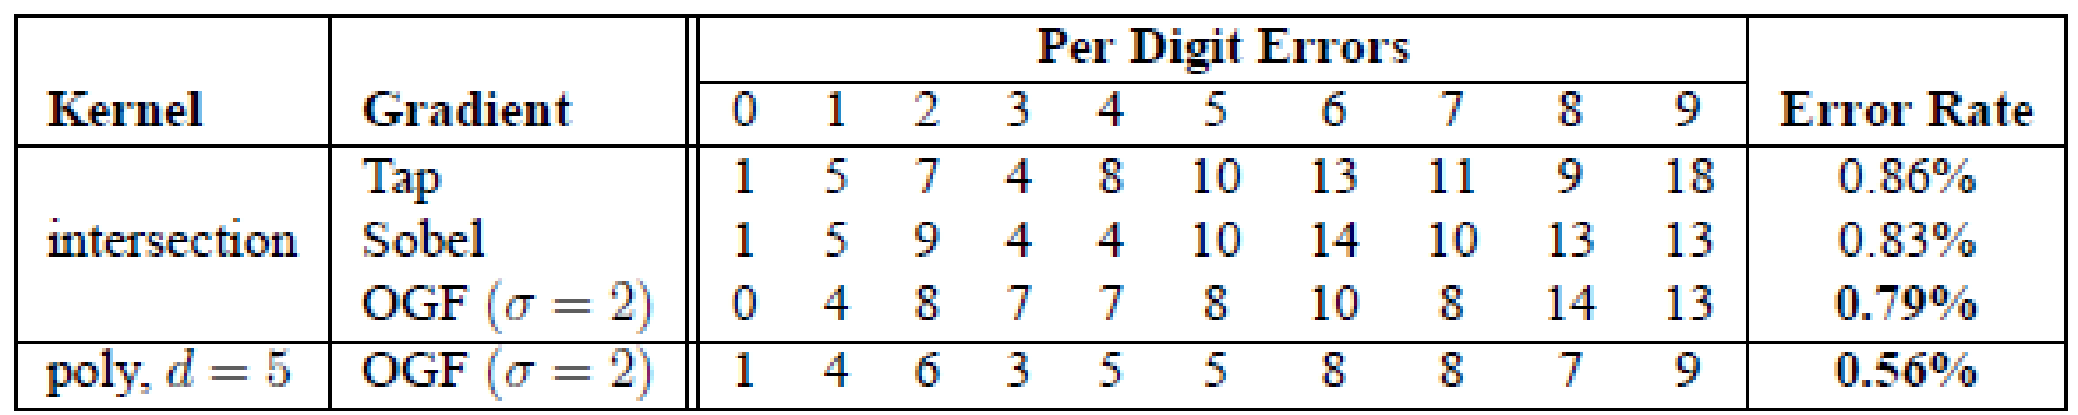
Results 2
Errors on MNIST (10,000 test examples).
The best error rate using the intersection kernel SVM is 0.79% using OGF filters.
Training a polynomial kernel SVM on the same features gives an error rate of 0.56%
However the polynomial kernel SVM is at least three orders of magnitude slower than the intersection kernel SVM during classification
_{Tap → Tap Filter}
_{OGF → Oriented Gradient Filter}

Slide 40
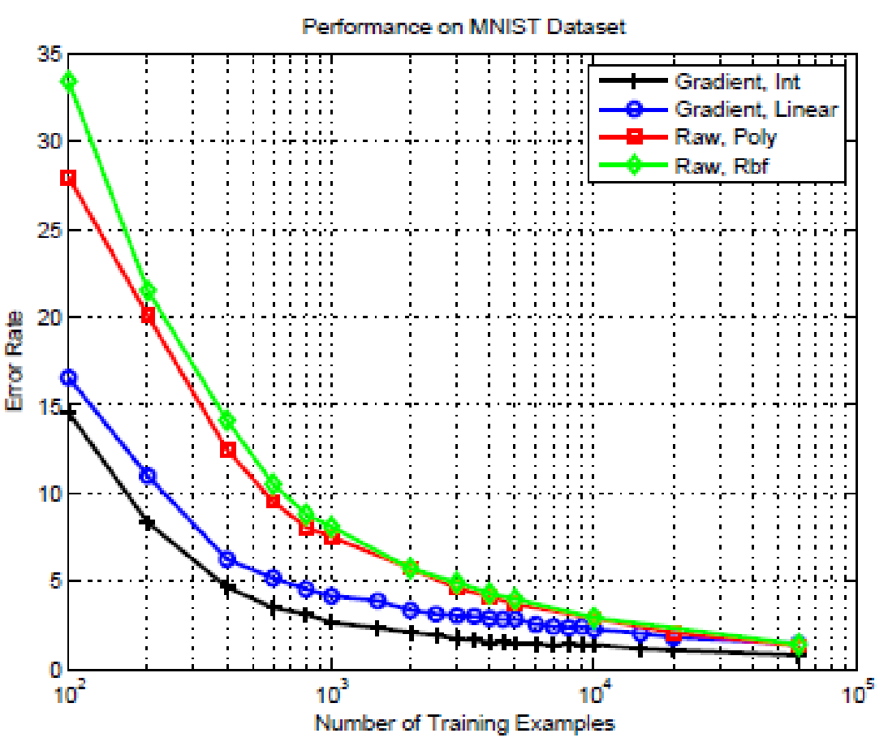
Comparison of Kernels
For various training sizes using pyramid features
With gradient features the error rates are 0.79% using intersection kernel and 1.44% using linear kernel SVM.
With raw pixel the error rates are 1.41% using rbf and 1.34% using the polynomial kernels.
The gradient features perform better using the linear and intersection kernels compared to rbf and polynomial kernels significantly when the number of training data is small
suggesting that the gradient features capture the invariances in the digits quite well.
We did not train the polynomial and rbf kernel SVMs on the gradient features as both the training and test time were very high.

Slide 41
Complexity Considerations
Linear kernels are the fastest
Intersection kernels are nearly as fast, using the “Fast Intersection Kernel” (Maji, Berg & Malik, 2008)
Non-linear kernels such as the polynomial kernel or Gaussian radial basis functions are the slowest, because of the need to evaluate kernel products with each support vector. There could be thousands of support vectors!

